Slide 1
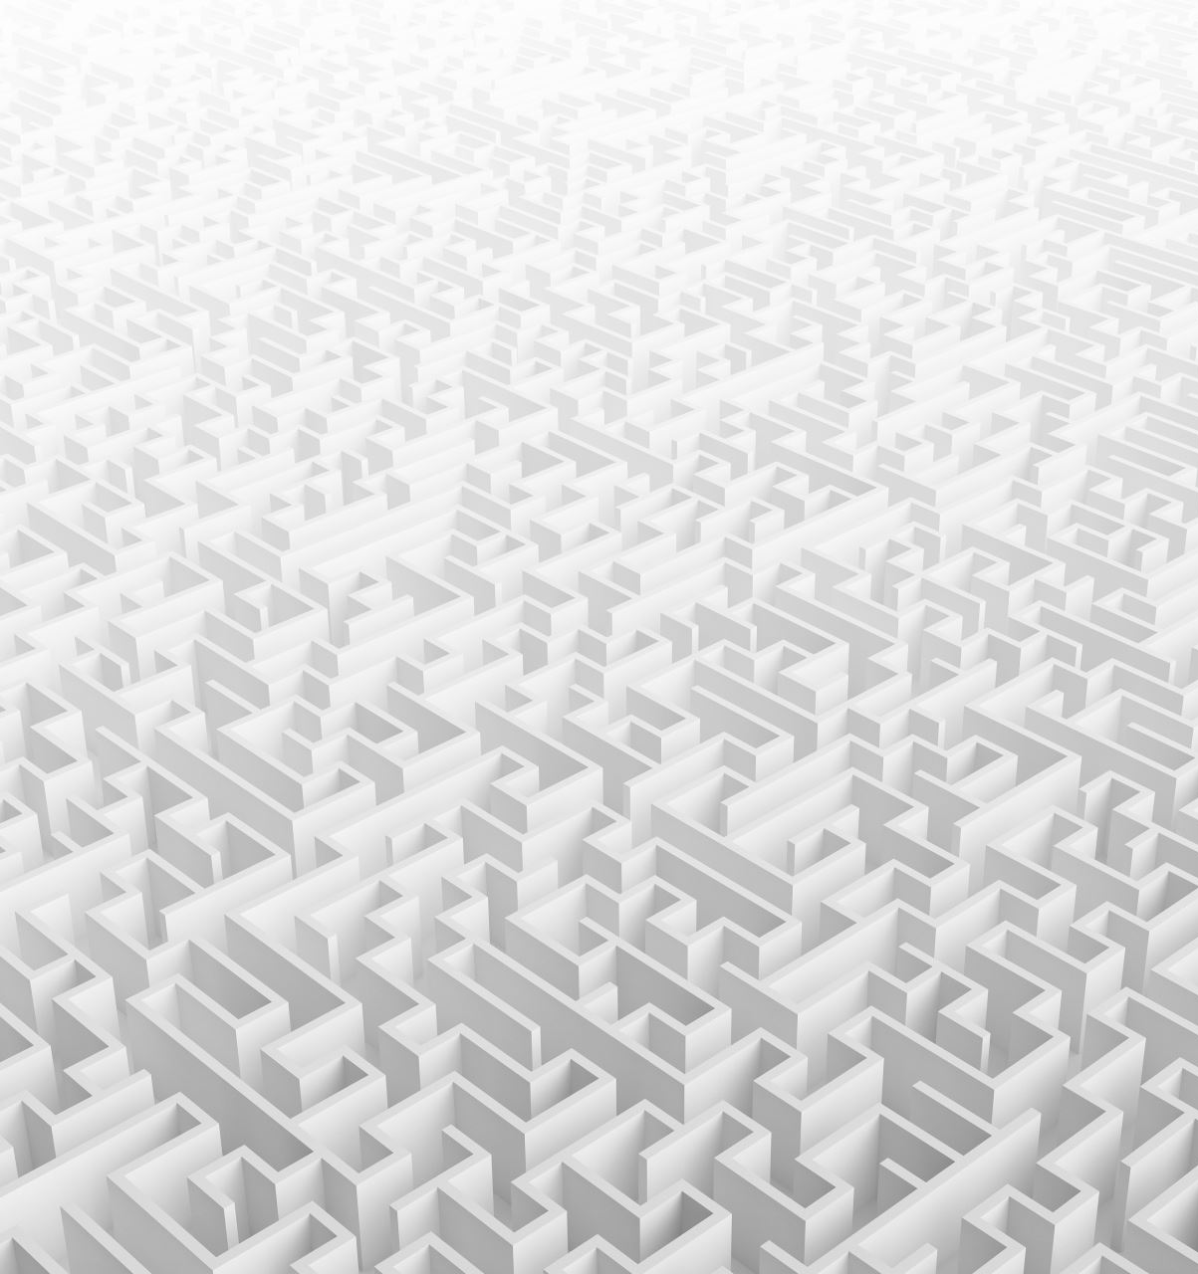
Random Maze Solver

Slide 2
Introduction
Importance of Mazes:
Used in computer science and robotics to evaluate search heuristics.
Classical Algorithms: DFS and BFS.
Limitations: High computational resource demand, time-consuming for large mazes
Alternative Approach: Random particle motion leveraging stochastic properties.

Slide 3
Problem Statement
Objective: Move a particle from a start point to an exit point in a 2D grid maze.
Challenge: Find a probabilistic path avoiding walls and obstacles.
Movement: Particles move up, down, left, or right but not diagonally.

Slide 4
Algorithmic Approach - Serial Implementation
Initialization: Place a particle at the maze's start.
Random Movement: Moves randomly in four directions.
Backtracking: Uses a stack to record the path.
Exit Detection: Continue until the exit is found.

Slide 5
Algorithmic Approach - Parallel Implementation
Parallelism with OpenMP:
Multiple particles move independently.
Each thread represents a particle.
Common flag stops all threads once the exit is found.

Slide 6
Performance Evaluation
Serial Execution: Only one particle moves randomly.
Slow and time-consuming due to backtracking.
Parallel Execution: Multiple particles search simultaneously.
More efficient due to concurrent processing.

Slide 7
Performance Results
Serial Algorithm Parallel Algorithm | Serial Algorithm Parallel Algorithm
0.219318 seconds | Parallel execution time with 1 particle: 0.0013578 seconds Parallel execution time with 10 particles: 0.0010642 seconds Parallel execution time with 100 particles: 0.000874 seconds Parallel execution time with 500 particles: 0.0013041 seconds Parallel execution time with 1000 particles: 0.0007907 seconds

Slide 8
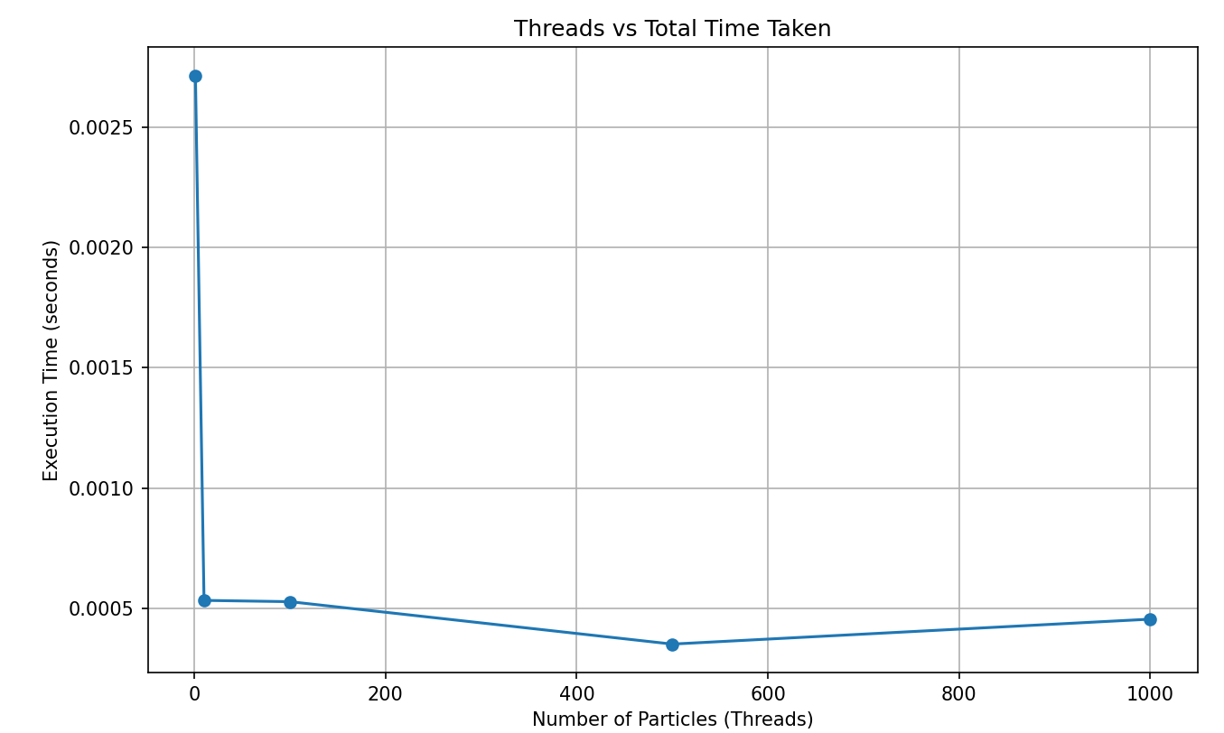
Graph: Thread vs Total time taken

Slide 9
Conclusion
Findings:
Parallel implementation significantly
improves performance.
Benefits:
Faster maze solving with higher particle count.
Future Work:
Refine the random movement algorithm.
Implement better backtracking methods.
Extend to other search and optimization problems.

